Slide 1
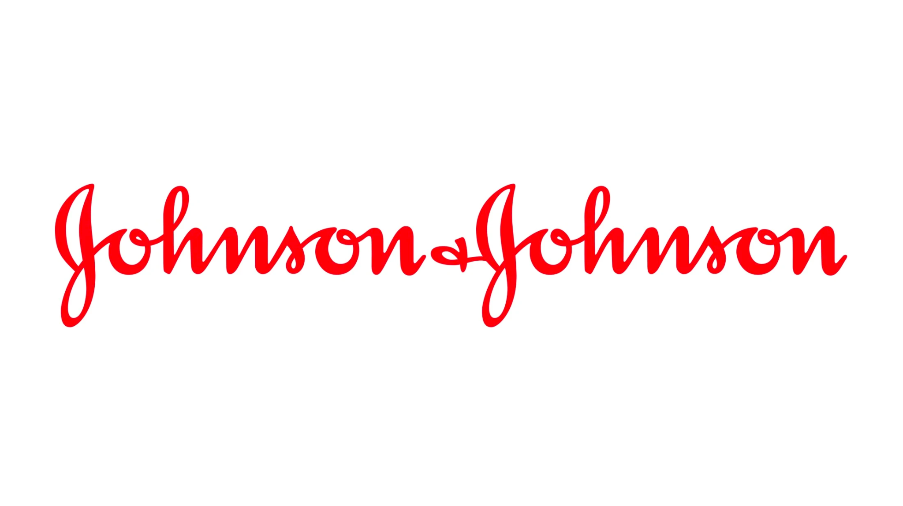
Johnson & Johnson Case Study 24
Danny Huang
Professor Kawalek
BPL 5100 CMWB [29719]
Individual Assignment

Slide 2
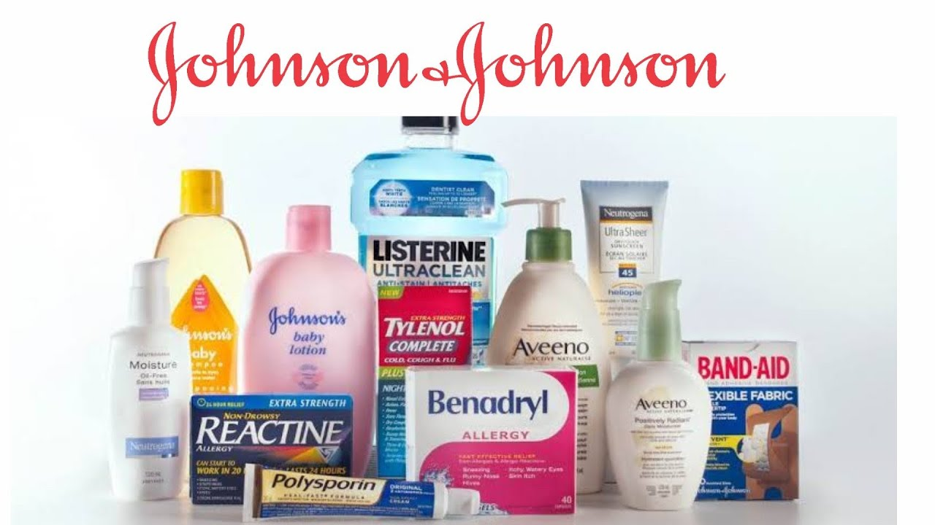
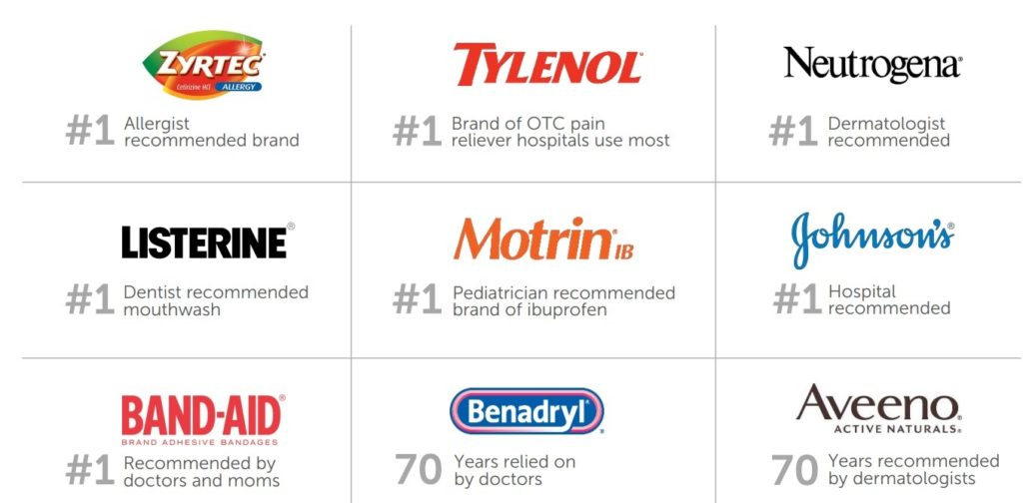
J&J Continues to be the Largest Healthcare Company Through Their Successful Product Line
Johnson & Johnson is an American multinational corporation founded in 1886 by James Wood Johnson, Robert Wood Johnson I, and Edward Mead Johnson. Johnson & Johnson first started as a company that created surgical dressing. Two years later, they founded innovative first aid kits to treat wounds and injuries. This is the first commercial first aid kit being pioneered. J&J continues to achieve milestones by developing new products and services.
Johnson & Johnson Successful Products:
Band-Aids Tylenol Baby Powder | Used to cover wounds and injuries Used for pain and relieves Used to prevent or treat diaper rash

Slide 3
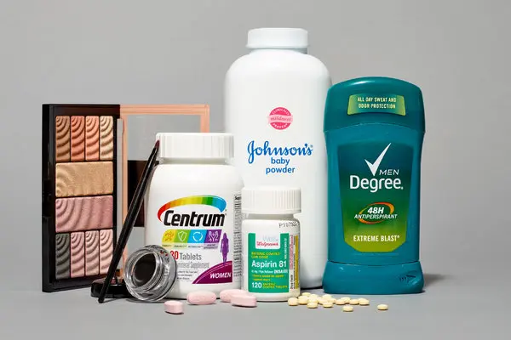
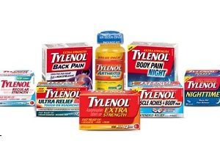
J&J Faced Challenges From their Products as it’s Quality and Value Depreciates
Talcum Products
→ Baby Powder
→ Shower to Shower
→ Gold Bond
Asbestos are presented in Talc contained products. Talc is used in cosmetic products like baby powder. Asbestos which is an included mineral and contains carcinogen which can cause serious health issues.
Manufacturers, distributors, brands and retailers of talcum powder have faced numerous of lawsuits over their talc products. Litigation is still ongoing.
Talc Products such as the baby powder develop ovarian cancer due to asbestos contamination. Litigation also includes lawsuits claiming talc-cancer links to fallopian tube cancer and peritoneal cancer.
Tylenol
→ Vanquish
→ Vicks
→ Zicam
There is evidence that a women who took tylenol that contains acetaminophen during pregnancy with giving birth to a child with autism. It was alleged that J&J did not warn of potential dangers when selling products that contain acetaminophen.
Although the products are sourced from different suppliers, the active ingredient at issue is the same. Litigation is still ongoing and there will likely be several files against manufacturers involved.
There are concerns for many pregnant woman to take products that contain acetaminophen. The FDA and other medical groups needs to establish whether a link exists between neurobehavioral conditions and acetaminophen.

Slide 4
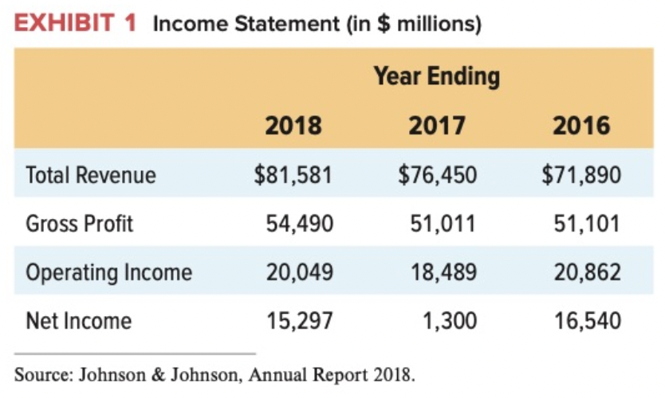
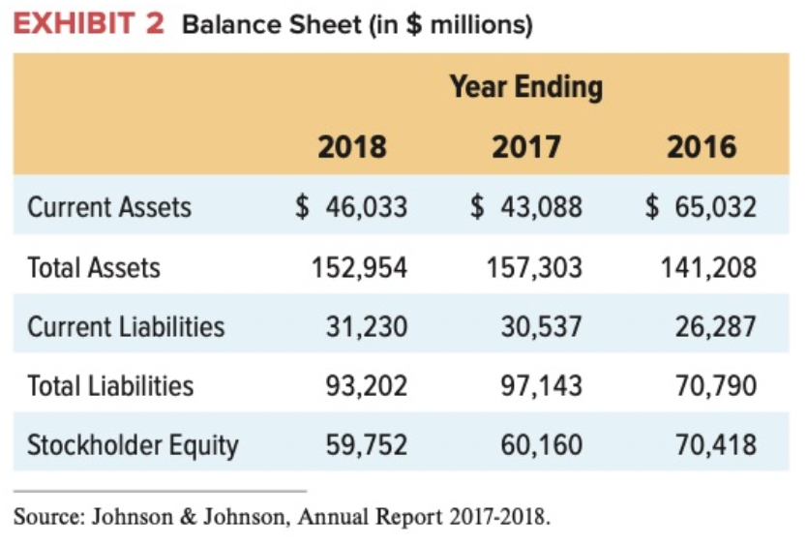
J&J has struggled to find a way to manage its vast portfolio of diversified businesses.
J&J has grown by acquisitions and it has developed a into a more complex enterprise, made up of 250 different subsidiaries.
J&J granted self-governance to each of the firms.
Autonomy has prevented J&J from administering a strong set of controls, such as for quality standards.
It has also prevented the firm from pursuing opportunities on which its various units could combine their different areas of expertise.
William C. Weldon attempted to direct his efforts on exerting more control of the various businesses.
Their most well known products of the three different division are J&J baby care products, Band-aid, and Visine eye drops.
J&J adopted a decentralized approach in managing its different businesses.

Slide 5


J&J Needs to Take Strategic Actions to Address the Challenges and Accomplish Their Goals
J&J needs leaders who have qualified skills and experience:
To manage quality control and recognize challenges
To manage its vast portfolio of diversified businesses
To have greater control with its emphasis on autonomy throughout the organization
To have greater control over its business units
To set the bar high and provide safety products to consumers
Chairman of J&J, Alex Gorsky:
The firm’s huge scale could have a rare asset for negotiating deals.
The work on app in collaboration with Apple’s watch to provide better data on cardiac issues.
Incorporate a decentralized structure with more empowerment for its workers in various levels of management
Provide more direction for the units and encourage them to collaborate in order to pursue emergent opportunities.
William C. Weldon
Alex Gorsky

Slide 6
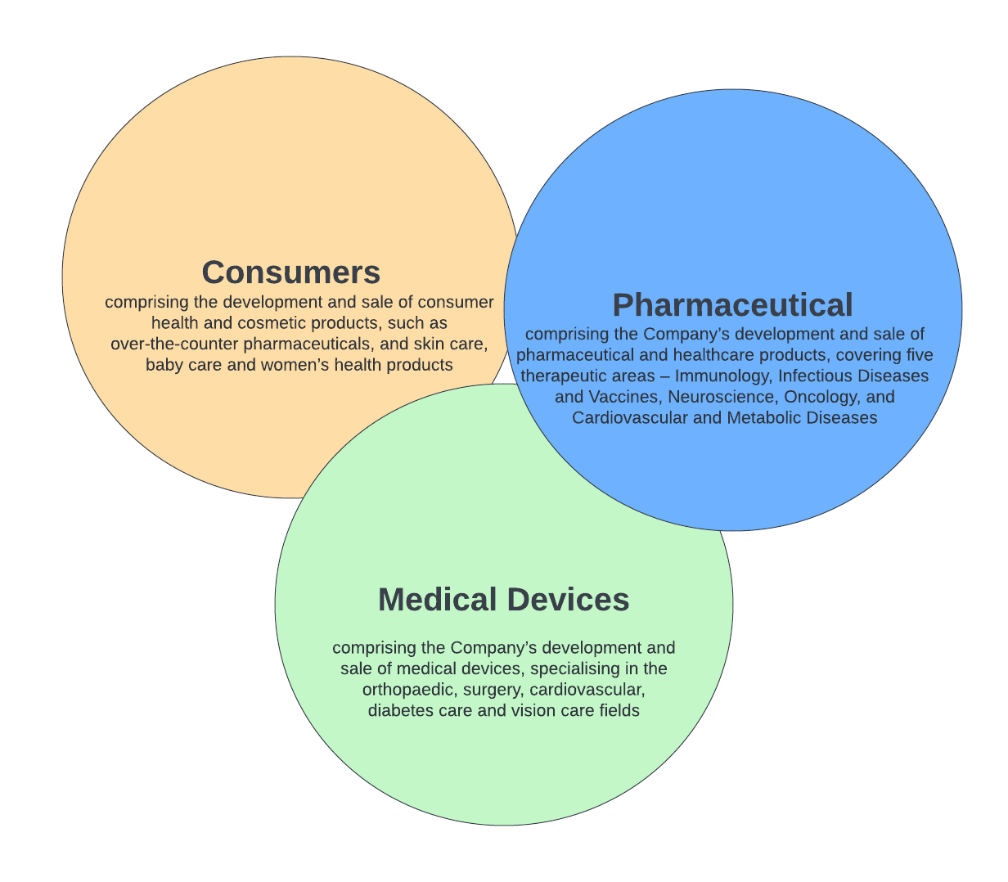

J&J Needs to Take Accountability and to Better Manage Quality Control to Maintain their Spot in the Healthcare Industry
Strategies:
Business Model:
J&J has a wide variety of products and divisions. The company should reposition themselves and focus on selling over the counter medication and drugs. J&J make the most sales in pharmaceutical products with about $45.6B. While they make $23B in Medical Device Sales, and $14.1B in Consumer Health Sales.
J&J’s business model is reflected most notably in its M&A strategy and subsequent integration approach.
J&J takes on a decentralized approach to management and focusing on their people and values. They need a decentralized organizational structure to accommodate to greater autonomy within their organization.
J&J strives to “improve access and affordability, create healthier communities, and put a healthy mind, body and environment within reach of everyone, everywhere.” They’re accountable for their promise to the community and priority on human health care.
Alex Gorsky became the CEO of J&J in 2012. He promoted a more diverse and inclusive culture at Johnson & Johnson. Additionally, pushing for growing leadership.
Establishing quality policies and standards will promote consistency in quality requirements across all Business and Functional units
Operational Model:

Slide 7

J&J Should Prioritize Patients and Physicians While the Company Spends Tremendously on R&D to Gain Medical Innovations and Insights
Johnson & Johnson has been spending heavily on research and development for many years, taking its position among the world’s top spenders. They spent approximately $12.159B in 2020. It has been spending about 12 percent of its sales on about 9,000 scientists working in research laboratories around the world. This provided the opportunity for the three 3 divisions to introduce new products. Additionally, Johnson & Johnson have a duty to fulfill their mission in serving the community with accessible, affordability and creating a healthier community.
San Francisco Bay Area: R&D Facility - 2022
A new facility built to strengthen the presence of healthcare innovations. The new facility will bring people together to solve great challenges. Scientist will focus on solving for new solutions for everything from infectious diseases to retinal diseases with advance technologies and data science.

Slide 8
J&J Aims to Achieve Consistent Credibility and Brand Loyalty to Rebuild their Great Brand Reputation
The challenges that arose in J&J includes the quality of their products and lawsuits in regards to Cancer and Autism, the vast portfolio that the company have are hard to manage and their brand reputation decrease when products contain traces of asbestos that can cause cancer.
They need to have strong and qualified leaders such as a CEO, COO, and other Board of Directors who can manage quality control, vast portfolio, and increase revenue, while not damaging brand reputation and support decentralizing the company structure. Leaders should have the capability of overseeing the day to day administrative and operational functions of a business.
The main strategy J&J needs to implement is decentralizing their organization by using a divisional business structure. J&J consist of 3 divisions which includes consumer products, pharmaceutical products, medical devices. Each division should have a leader to manage those divisions.

Slide 9
Bibliography
Simon, Shelby. “Talcum Powder Lawsuit Update November 2022.” Forbes, Forbes Magazine, 10 Oct. 2022, https://www.forbes.com/advisor/legal/product-liability/talcum-powder-update/#:~:text=Talc-containing%20products%20implicated%20in%20ovarian%20cancer%20lawsuits%20include,Extra%20Strength%20Body%20Powder%206%20Old%20Spice%20powder.
Packer-Tursman, Judy. “Debate over Possible Acetaminophen-Autism Link Heads to Court.” UPI, UPI, 28 Oct. 2022, https://www.upi.com/Health_News/2022/10/28/acetaminophen-pregnancy-autism-lawsuits/9701666296922/.
Ltd, All Answers. “Analysis of Johnson &amp; Johnson's Strategic Framework.” UKDiss.com, UKDiss, 27 July 2022, https://ukdiss.com/examples/johnson-and-johnsons-strategic-framework-application.php?fbclid=IwAR37bpmf2VWgt3NiY7bkFpt95B51Qlr2AsNTgWSLQLRwiykMUeIvI_NED1s.
“Johnson &amp; Johnson.” Cleverism, 8 Nov. 2017, https://www.cleverism.com/company/johnson-and-johnson/.
KKing. “Johnson &amp; Johnson.” Technology and Operations Management, 8 Dec. 2015, https://d3.harvard.edu/platform-rctom/submission/johnson-johnson/?fbclid=IwAR2QD36uslAc9dHg-cCtxg5WveMD93hziYX-0eGu-W_sZEL8kunL93dOEno.
“Johnson &amp; Johnson – Products, Recalls, Lawsuits &amp; Scandals.” Drugwatch.com, https://www.drugwatch.com/manufacturers/johnson-and-johnson/#:~:text=Top%20revenue%2Dproducing%20devices%20include,Aid%2C%20Pepcid%2C%20Aveeno%2C%20Zyrtec.
“ESG Policies &amp; Positions.” Content Lab U.S., https://www.jnj.com/about-jnj/policies-and-positions.
Ozaist, Liz. “Johnson &amp; Johnson Debuts a Groundbreaking R&amp;D Facility in the San Francisco Bay Area.” Content Lab U.S., Johnson &amp; Johnson, 20 Sept. 2022, https://www.jnj.com/latest-news/johnson-johnson-debuts-r-d-facility-in-san-francisco-bay-area.

